Slide 1
CATEGORIES COMPARISON CASES
@EINARWH
Notes:
Hi everyone! This is the title of my talk, and sort of also the agenda. We will be talking about categories, comparison and cases. Which is to say, we will look at how we use these things, these tools, to try to make sense of the world or the domain we operate in. Which is to say, we will be talking about modelling.

Slide 2
ME
Notes:
A few words about me. I have been making software for twenty years. Most of my career I have been writing code. Very recently I have started working as a socio-technical advisor the Norwegian Labour and Welfare Administration. NAV is a large organization. We administer a third of the national budget through schemes such as unemployment benefit, work assessment allowance, sickness benefit, pensions, child benefit and cash-for-care benefit. And we have

Slide 3

Notes:
A few words about me. I have been making software for twenty years. Most of my career I have been writing code. Very recently I have started working as a socio-technical advisor the Norwegian Labour and Welfare Administration. NAV is a large organization. We administer a third of the national budget through services such as unemployment benefit, work assessment allowance, sickness benefit, pensions, child benefit and cash-for-care benefit. And we have a lot of categories.

Slide 4
CATEGORY THEORY

Slide 5
THE FOLK THEORY OF CATEGORIES

Slide 6
1
THINGS COME IN WELL-DEFINED CATEGORIES

Slide 7
2
CATEGORIES ARE CHARACTERIZED BY SHARED PROPERTIES

Slide 8
3
THERE IS ONE RIGHT TAXONOMY OF THE CATEGORIES

Slide 9
THESE ARE ALL WRONG

Slide 10
CATEGORY PRACTICE

Slide 11
HELLO FELLOW APES
HELLO FELLOW APES
HELLO FELLOW APES
Notes:
I needed a way to introduce the topic that I want to discuss today, and this is what I came up with. Hello fellow apes! And what I’m going for here, is some sort of reaction to that statement. I’m interested in the neurons being fired in your brains.

Slide 12
HELLO FELLOW HUMANS
Notes:
Or hello fellow sentient beings, perhaps. That would make you suspect that I might be an octopus or a cephalopod.

Slide 13
HELLO FELLOW SENTIENT BEINGS
Notes:
Or hello fellow sentient beings, perhaps. That would make you suspect that I might be an octopus or a cephalopod.

Slide 14
HELLO FELLOW OBJECTS
Notes:
You couldn’t possibly object to this, since we all know that the object is the superclass of all other things. But of course, it would be very vague, since I would also be greeting the chairs you’re sitting in, and everything else in the room.

Slide 15
HELLO FELLOW APES
Notes:
But I chose fellow apes, and the purpose was to be a little bit provocative, and to start us off with a little reflection.

Slide 16
WHY IS IT INTERESTING?
Notes:
Is it insulting in some way?

Slide 17
IS IT WRONG?
Notes:
Is it insulting in some way?

Slide 18
DO WE AGREE THAT WE ARE APES?
Notes:
Maybe first we should settle this. Do we agree that we are apes?

Slide 19
WHAT IS AN APE?
Notes:
And to answer that, we need to think about what an ape is. Or perhaps rather, what the category of apes is. What does it mean to belong to the category of apes?

Slide 20
APE (TECHNICAL)
Notes:
Technically, apes form a clade of animals with a common ancestor. This approach to classification is known as cladestics, and it’s how we currently categorize species.

Slide 21
IS-A
HUMAN
APE
Notes:
Technically, then, there is no doubt. We can say precisely what a human is and what an ape is, and there is an is-a relationship between the two categories. Nothing more to discuss.

Slide 22
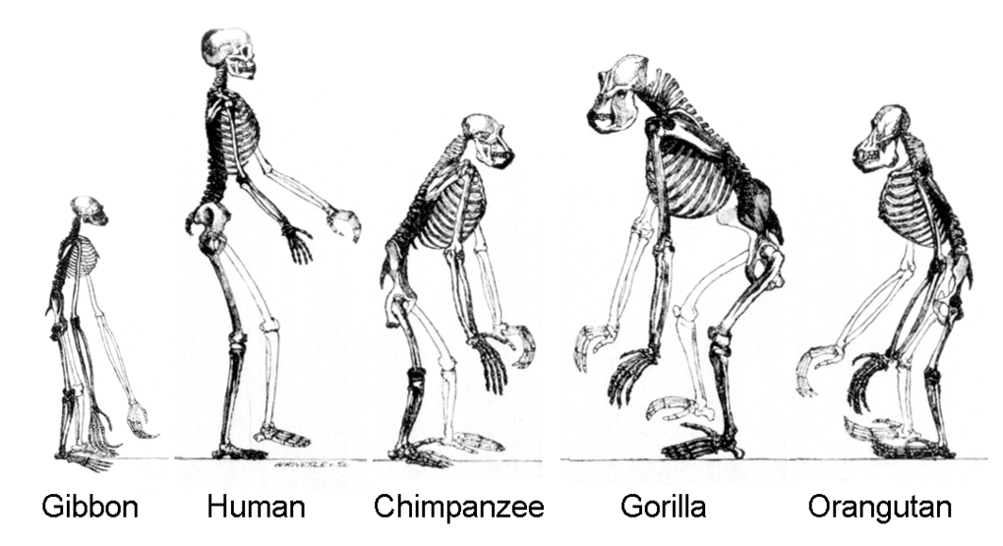
Notes:
Here we are in good company at the family reunion. We even got flanked by a gibbon, so we can’t easily escape the party. This is us, the human ape and our relatives.

Slide 23
WE ARE THE MOST COMMON APE
Notes:
In fact, we are by far the most common ape on the planet.

Slide 24
1 : 26000
Notes:
This is the chimpanzee-to-human ratio in the world, by the highest estimated number of chimpanzees, which is 300000. For every chimpanzee, there are 26000 humans. So it’s not even a competition. Almost every ape is a human ape.

Slide 25
A HUMAN IS JUST A HOMINID IN THE CATEGORY OF SIMIANS, WHAT’S THE PROBLEM?
Notes:
So we can’t really protest too much. A human is just a hominid in the category of simians.

Slide 26
TYPICALITY
Notes:
The problem, I think, has to do with typicality. We might be the most common ape, but we are definitely not the most typical ape. Which is perhaps.a little bit surprising and a little bit striking. But it’s actually not unique. We have the same situation for birds. A few years ago I did a talk where I argued that the sparrow is the most typical bird there is, but it’s not the most common bird. By far the most common bird is the chicken, which can’t even fly properly. It’s a pathetic bird. But humans like to eat chicken, so there’s a lot of them.

Slide 27
YES WE ARE TECHNICALLY APES BUT
Notes:
While we have more or less grudgingly come to accept that we belong to the same group as the other animals that we call apes, we don’t think of ourselves as typical apes. We’ve seen the diagrams, we’re seen the family picture, but we don’t feel like we belong.

Slide 28
WE DON’T USUALLY THINK OF OURSELVES AS APES
Notes:
We don’t think of ourselves as apes most of the time.

Slide 29
WE ARE PRIMARILY HUMAN
Notes:
Instead, we think of ourselves as human.

Slide 30
REASONS! EVIDENCE!

Slide 31
NOT HAIRY ENOUGH
Notes:
First of all, we’re not hairy enough. Typical apes have more hair on their bodies than we do.

Slide 32
TOO UPRIGHT
Notes:
We are too upright to be a typical ape. We walk on two feet.

Slide 33
NOT LONG ENOUGH ARMS
Notes:
Our arms are too short.

Slide 34
WEAK FOOTGRIP / POOR CLIMBER
Notes:
We have relatively weak footgrip. We are poor climbers. We are better suited to a life on the ground than a life up in the treetops. Some of us are afraid of heights.

Slide 35
TOO INTELLIGENT
Notes:
We are much too intelligent to be considered a typical ape. We have even labeled ourselves, not too modestly, as the wise ape, homo sapiens.

Slide 36
NOT QUITE FOND ENOUGH OF BANANAS
Notes:
And of course, even though we might eat the occasional banana, the typical ape – in our perception – is much more of a banana-holic. We can easily picture a chimpanzee or a gorilla chain-eating a whole bunch of bananas.

Slide 37
BANANAS?
Notes:
Which turns out to be wrong. Bananas distinguish humans from the other apes in that we eat more of them.

Slide 38
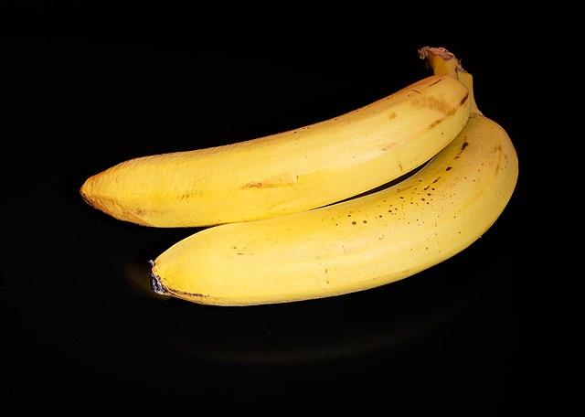
Notes:
Typically when we talk about bananas, we mean the cultivated banana known as the Cavendish banana. It is a domesticated plant that the other apes can only get from us. We are the banana-dealers of the animal kingdom. Apes will eat bananas, but actually prefer grapes.

Slide 39
NOT QUITE FOND ENOUGH OF BANANAS
Notes:
So we ended up here.

Slide 40
WE ARE DIFFERENT
Notes:
But it doesn’t matter. To summarize. We are different somehow. Yes, there are similarities, but also so many differences that ape feels like a poor label for us.

Slide 41
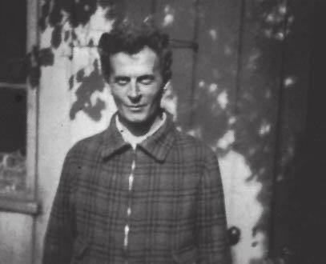
WITTGENSTEIN AGREES
Notes:
But it doesn’t matter. To summarize. We are different somehow. Yes, there are similarities, but also so many differences that ape feels like a poor label for us.

Slide 42
APE (CASUAL)
Notes:
In fact, you could say that there’s another notion of ape out there, that is *not* technical, and it is not designed to be precise. It is casual and informal. And in that category, we don’t really fit all that well.

Slide 43
SO ARE WE APES OR NOT?
Notes:
So the question then becomes, are we apes or not? This is very confusing! We know that technically, we are apes, but we don’t feel like apes. It doesn’t feel like our identity.

Slide 44
DIFFERENT CONTEXTS
BIOLOGY (TECHNICAL)
EVERYDAY (CASUAL)
APE AS HOMONYM
Notes:
But it’s not really that difficult. What we have are two different contexts, and two different categories, denoted by the same word, APE. In biology, we have a technical category of APE, which unambivalently includes humans. There is no discussion about it. We share the same common ancestor. By definition, we are apes. In the everyday category of ape, however, things are more blurry. We know, intellectually, since Darwin, that we are apes. But our membership is fuzzy and problematic. We’re an edge case. Often we think of ourselves outside the ape category, and require that apes be hairy climbers.

Slide 45
WE ARE CONFUSED
Notes:
But still we are confused, and the reason is that we don’t distinguish between the contexts. We don’t even know that we should distinguish between the contexts. In fact, an interesting question might be, should we distinguish between these contexts? Or is the everyday category just wrong, and we should adopt the category used in biology? Would that solve our problems?

Slide 46
HOW APE ARE WE?
Notes:
We’ll get back to that. In the meantime, we might ask ourselves, how ape are we?

Slide 47
👏
Notes:
If all goes well, and you are a polite audience, this session might end by you as a group clapping. Which is to me the perfect example of human ape behavior. There is something very ape-like in clapping your hands together to make noise. And indeed other apes do clap their hands together, we’re not the only clapping ape. But other apes use it differently, for instance as a warning. We, however, are especially social-minded apes, and so we’re the only apes that have invented applause. So it very nicely captures our «human apeness»

Slide 48
Notes:
So that was the introduction. Where does that leave us?

Slide 49
WHAT IS A CATEGORY?
Notes:
Let’s start looking at categories a little more systematically now. What is a category?

Slide 50
WHAT DOES THAT EVEN MEAN?
Notes:
Well that’s an interesting question, but what does it mean?

Slide 51
WHAT IS A CATEGORY REALLY?
Notes:
So we might wonder what a category really is.

Slide 52
WHAT IS THE TRUE NATURE OF CATEGORIES?
Notes:
What is the true nature of categories?

Slide 53
AN IMPRACTICAL PERSPECTIVE
Notes:
That would be an impractical and theoretical perspective, which we could only speculate about. It’s like debating the nature of celestial beings. It’s not even clear that there is any such thing as «true nature».

Slide 54
PRACTICAL PERSPECTIVES
Notes:
But there are more practical perspectives.

Slide 55
HOW IS A CATEGORY REPRESENTED IN THE HUMAN BRAIN?

Slide 56
WE DON’T KNOW

Slide 57
BUT WE HAVE SOME MODELS

Slide 58
ESSENSIAL PROPERTIES ( CLASSICAL VIEW )

Slide 59
PROTOTYPICAL

Slide 60
What are categories used for?
Notes:
We could ask, what are categories used for?

Slide 61
WHY ARE CATEGORIES USEFUL?
Notes:
Or perhaps even why are categories useful?

Slide 62
SENSE-MAKING
Notes:
Categorization is a tool for sense-making, perhaps *the* tool for sense-making.

Slide 63
HOW WE ORGANIZE AND STRUCTURE INFORMATION ABOUT THE WORLD
Notes:
It’s how we organize and structure information about the world. Which is pretty important, since we find ourselves put into this world, and we can’t really escape it until we do. So while we’re here, being able to organize and structure information makes life easier.

Slide 64
THIS IS LIKE THAT THIS IS IDENTICAL TO THAT THIS IS ROUGHLY THE SAME AS THAT THIS IS DIFFERENT FROM THAT

Slide 65
COMPARISON, SORTING, CLASSIFICATION, DISTINGUISHING
Notes:
Well

Slide 66
ENABLES LANGUAGE
Notes:
It enables language. If everything were individual, ungrouped objects, they’d need unique names, and language would pretty useless.

Slide 67
ECONOMY OF THOUGHT
Notes:
Immediately we can say that categories are useful because they allow economy of thought.

Slide 68
EFFICIENT COMMUNICATION
Notes:
It also allows for economy of communication.

Slide 69
ENABLES INDUCTION
Notes:
Very importantly, it enables induction, right? So from my experiences with specific members of a category, I can create hypotheses about all or at least most members of the category.

Slide 70
ENABLES LEARNING
Notes:
At that in turn helps learning. It’s much easier to learn if we don’t need direct experience with every object in the world.

Slide 71
NAVIGATION, CHOICE, PLANNING, ACTION
Notes:
It enables navigation, choice, planning and meaningful action.

Slide 72
ENABLES US TO BE EFFECTIVE AGENTS IN THE WORLD
Notes:
In short, it enables us to be effective agents in the world.

Slide 73
CATEGORIZATION IN PRACTICE

Slide 74
CATEGORIZATION IS HILARIOUS

Slide 75
EVERYDAY CASUAL MODELLING

Slide 76
COARSE, IMPRECISE, PARTIAL

Slide 77
MOSTLY ADEQUATE

Slide 78
USEFUL

Slide 79
TO ACHIEVE GOALS

Slide 80
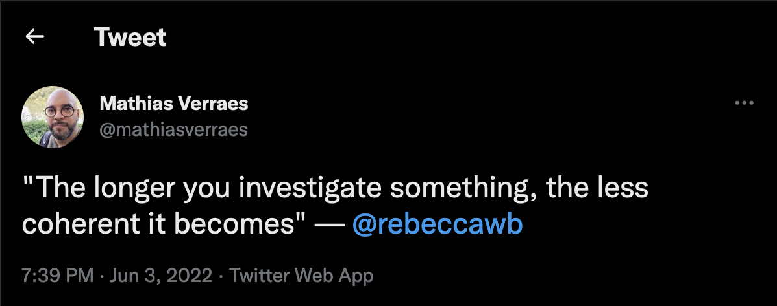

Slide 81
CATEGORY MEMBERSHIP

Slide 82
MEMBERSHIP EVALUATION
Notes:
Heuristics? Gut feeling?

Slide 83
NECESSARY AND SUFFICIENT?
Notes:
Heuristics? Gut feeling?

Slide 84
IS-A?

Slide 85
BOOLEAN VS RATING

Slide 86
EXAMPLES
Notes:
Heuristics? Gut feeling?

Slide 87
SOMETIMES IT’S EASY

Slide 88
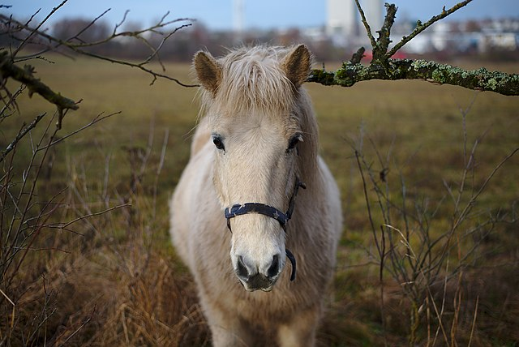
HORSE?

Slide 89
HORSE?
HORSENESS VERY HIGH

Slide 90
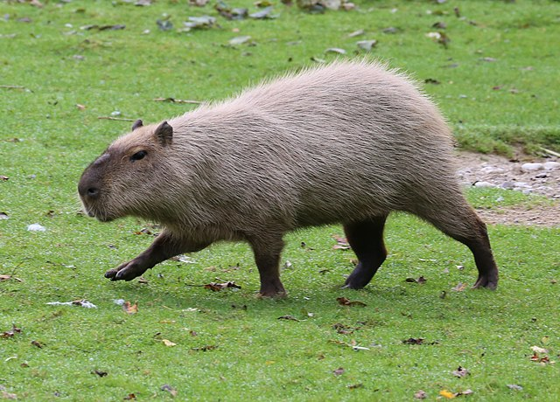
HORSE?

Slide 91
HORSE?
HORSENESS QUITE LOW

Slide 92
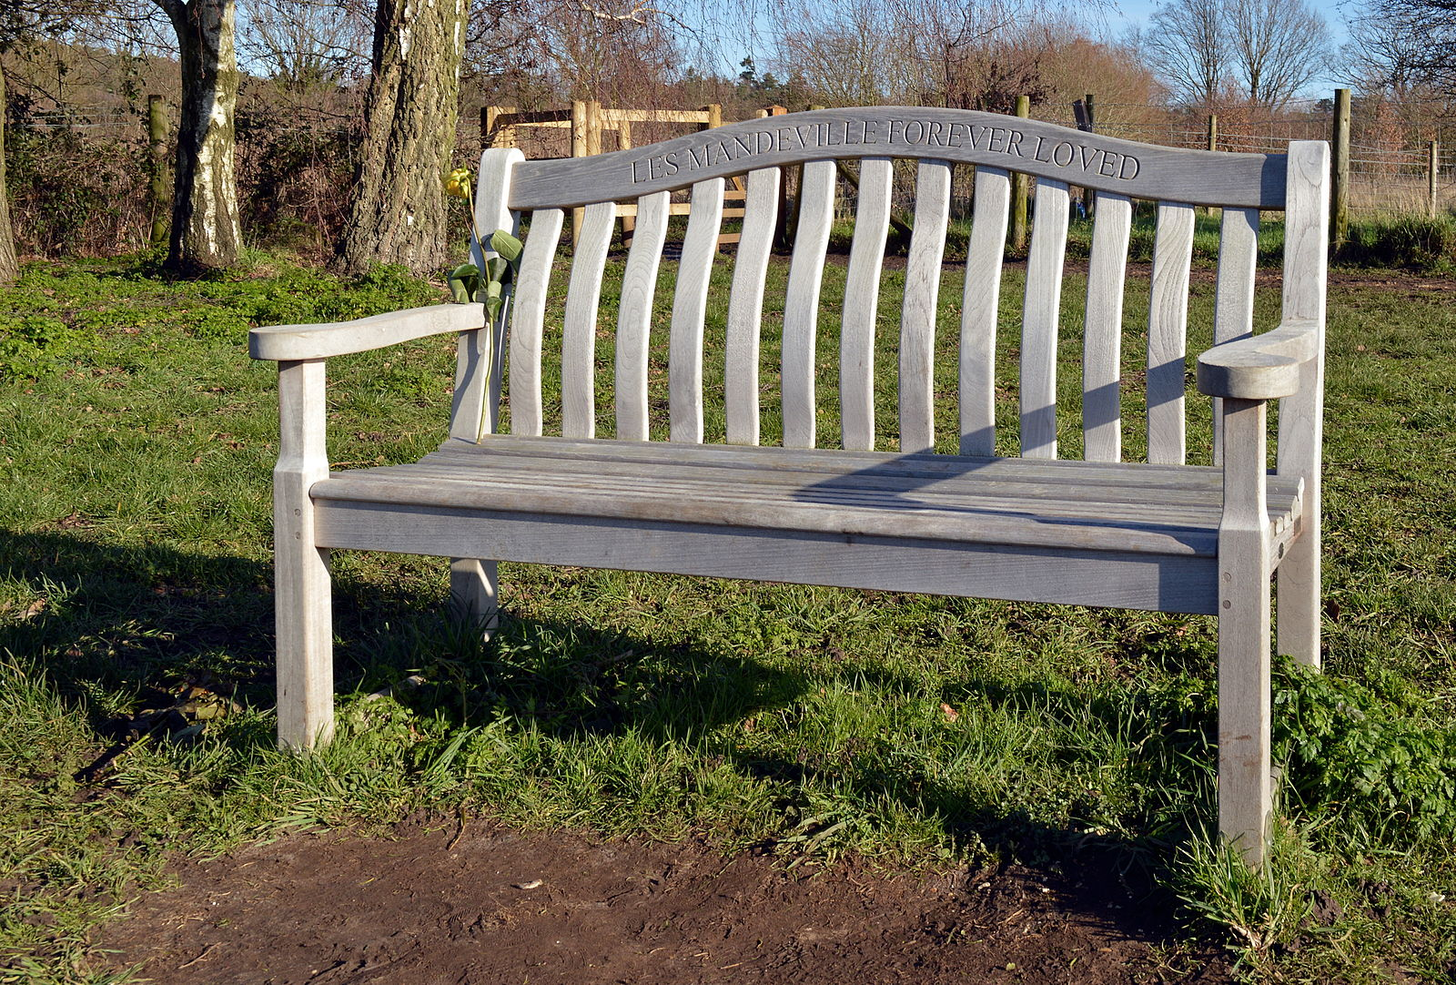
HORSE?

Slide 93
HORSE?
HORSENESS EVEN LOWER

Slide 94
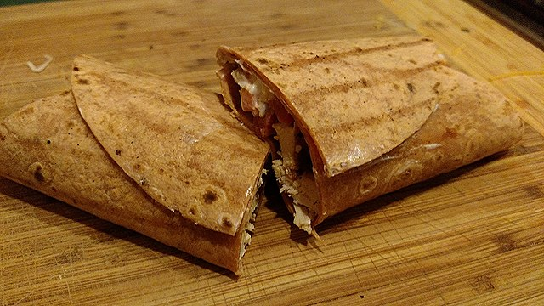
HORSE?

Slide 95
HORSE?
HORSENESS PRACTICALLY ZERO

Slide 96
SOMETIMES IT’S A LITTLE HARDER

Slide 97
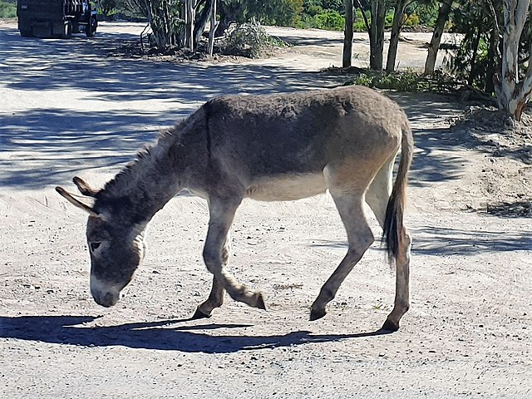
HORSE?

Slide 98
HORSE?
HORSENESS MEDIUM+

Slide 99
HORSENESS DEPENDS ON THE EXISTENCE OR ABSENCE OF OTHER CATEGORIES

Slide 100
DONKEYNESS SABOTAGES THE HORSENESS OF THE DONKEY

Slide 101
Notes:
Let’s try another.

Slide 102
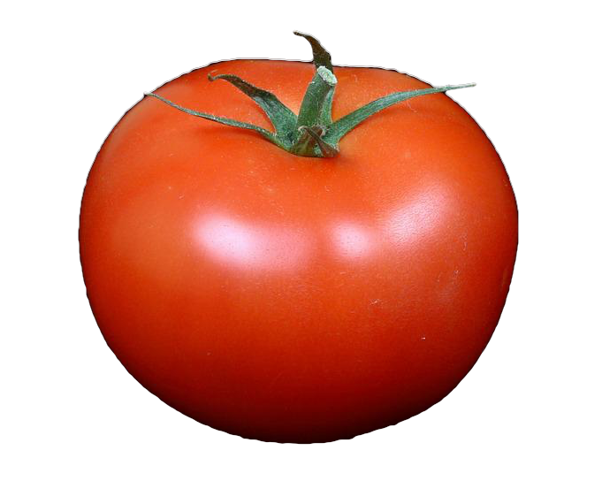
Notes:
What about this? These are tomatoes. What category do they belong to?

Slide 103
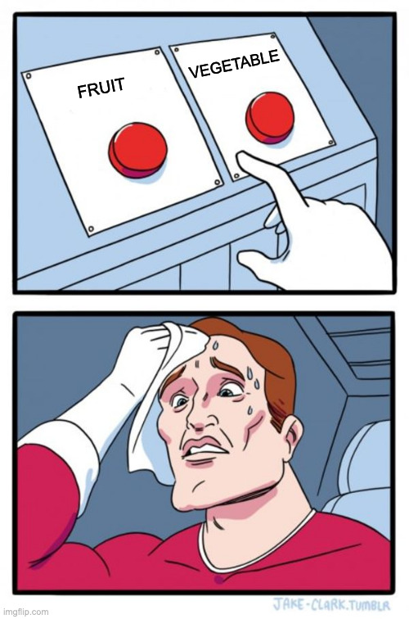
Notes:
What about this? These are tomatoes. What category do they belong to?

Slide 104
Notes:
What about this? These are tomatoes. What category do they belong to?

Slide 105
70% VEGETABLE
30% FRUIT
Notes:
To be honest, if you ask me, I’m going to say that a tomato is 70% vegetable and 30% fruit. This is my everyday casual categorization, and you’ll notice that I don’t really need to choose. But it’s mostly vegetable to me. I certainly would never put tomatoes in a fruit salad.

Slide 106
Notes:
To be honest, if you ask me, I’m going to say that a tomato is 70% vegetable and 30% fruit. This is my everyday casual categorization, and you’ll notice that I don’t really need to choose. But it’s mostly vegetable to me. I certainly would never put tomatoes in a fruit salad.

Slide 107
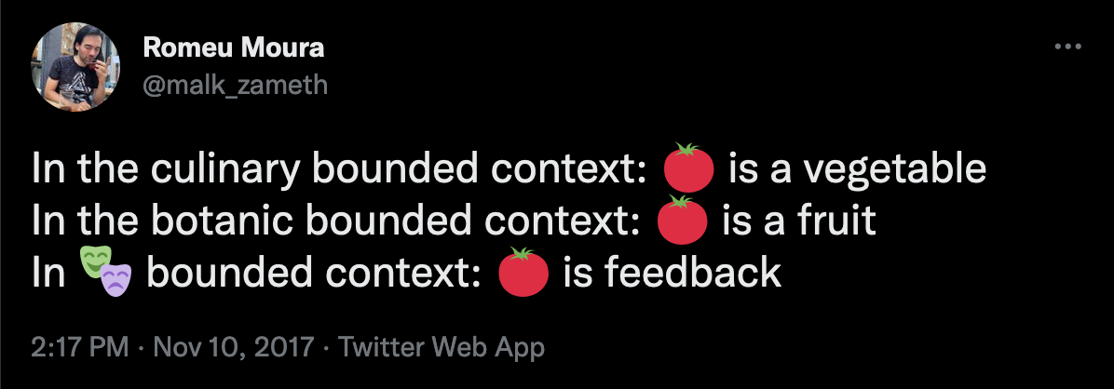
Notes:
Heuristics? Gut feeling?

Slide 108
CATEGORIES ARE CONTEXTUAL

Slide 109
CATEGORIES CAN BE FUZZY

Slide 110
DEGREES OF MEMBERSHIP

Slide 111
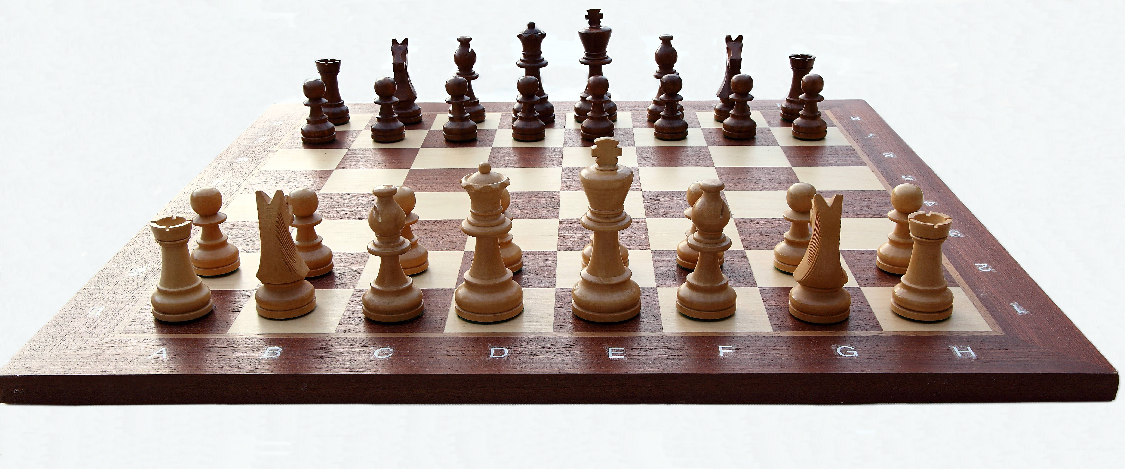

Slide 112
SPORT?

Slide 113
SPORT?
SPORT THAT IS ALSO A GAME

Slide 114
SPORT?
NOT A SPORT

Slide 115
RELATIONS BETWEEN CATEGORIES

Slide 116
TAXONOMIES

Slide 117
HIERARCHIES

Slide 118
GENERALISATIONS & SPECIALISATIONS

Slide 119
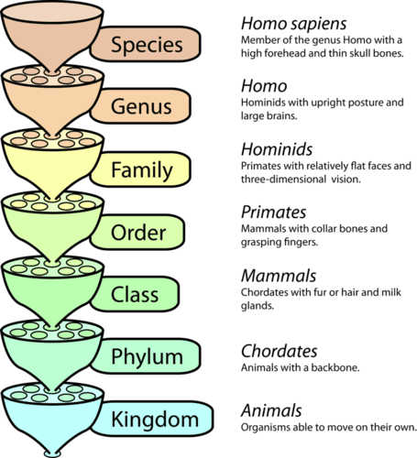

Slide 120
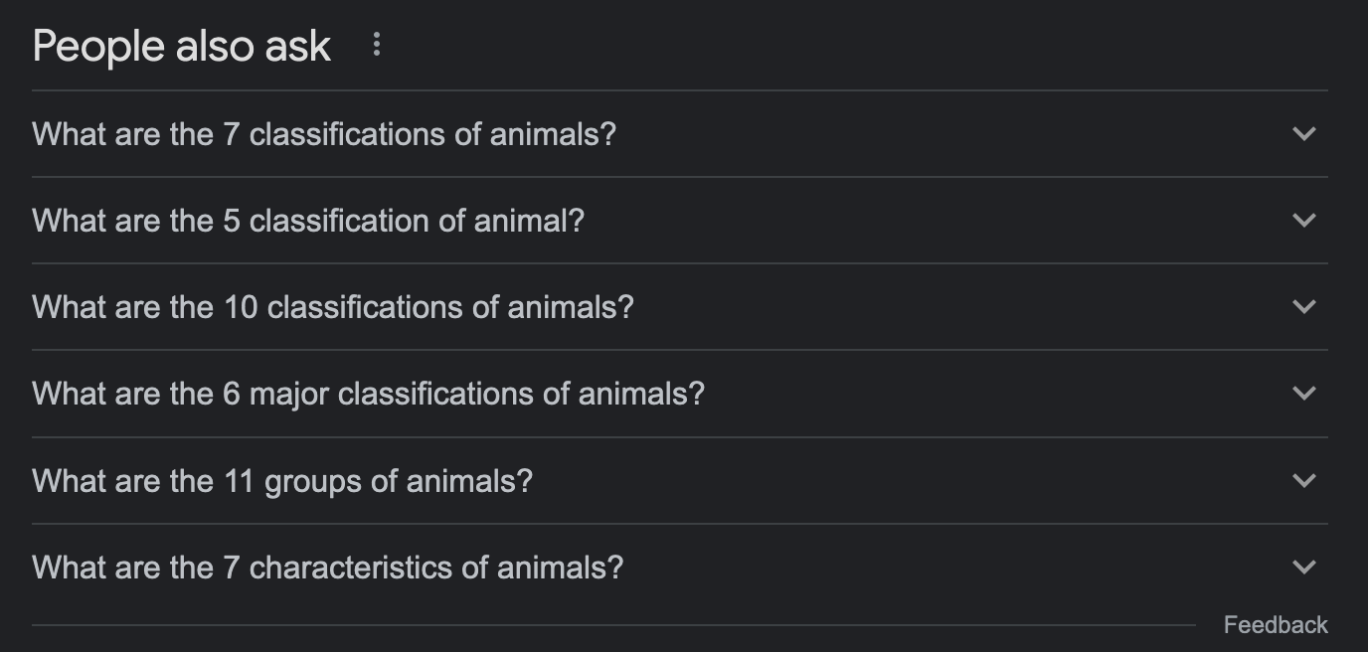

Slide 121
BASIC LEVEL CATEGORIES

Slide 122
BASIC LEVEL PREFERENCE

Slide 123
DIFFERENCE & INFORMATION

Slide 124
THIS IS AUTOMATIC

Slide 125
BASED ON UTILITY AND EXPERIENCE

Slide 126
DEPENDS ON EXPERTISE

Slide 127
CULTURE-SPECIFIC

Slide 128
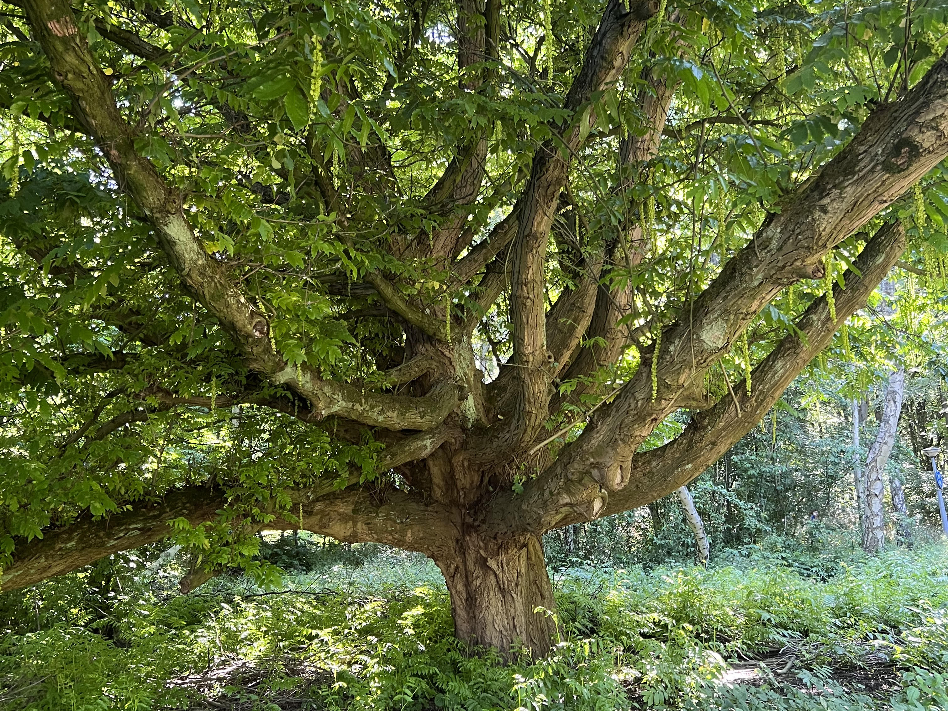

Slide 129
BUT IT’S ALWAYS MORE COMPLICATED

Slide 130
EXPERIMENT

Slide 131
tEst

Slide 132
1
2
3

Slide 133
LET’S RUN THE EXPERIMENT!

Slide 134
PICTURE #1

Slide 135
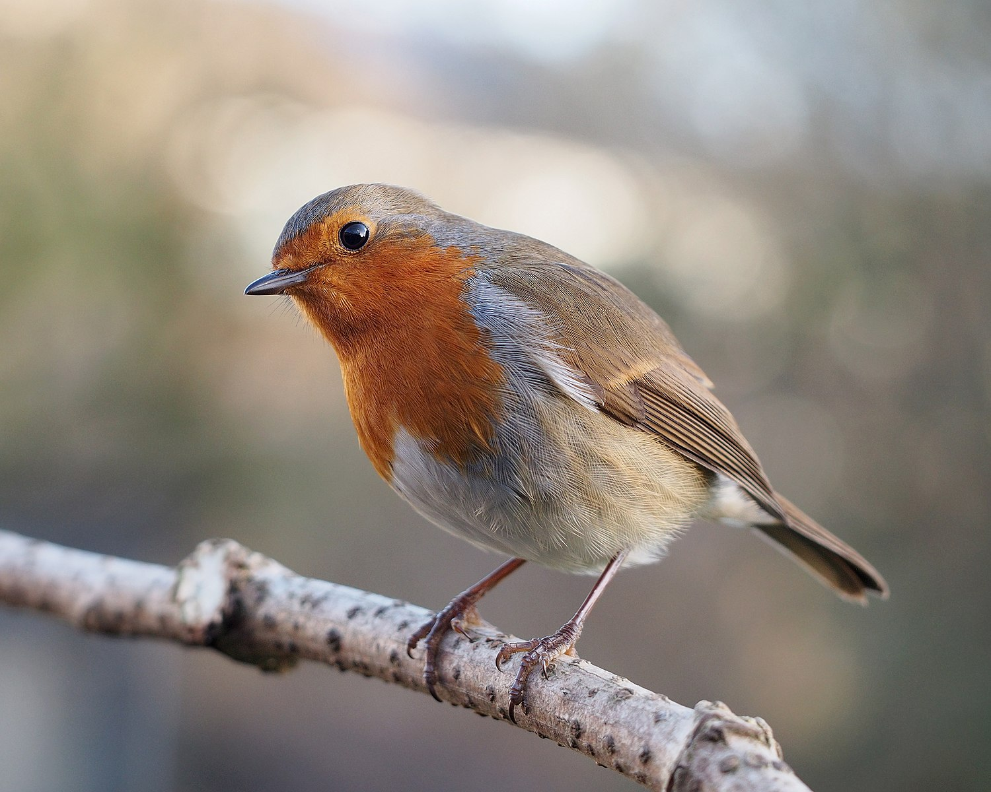
1
2
3

Slide 136
PICTURE #2

Slide 137
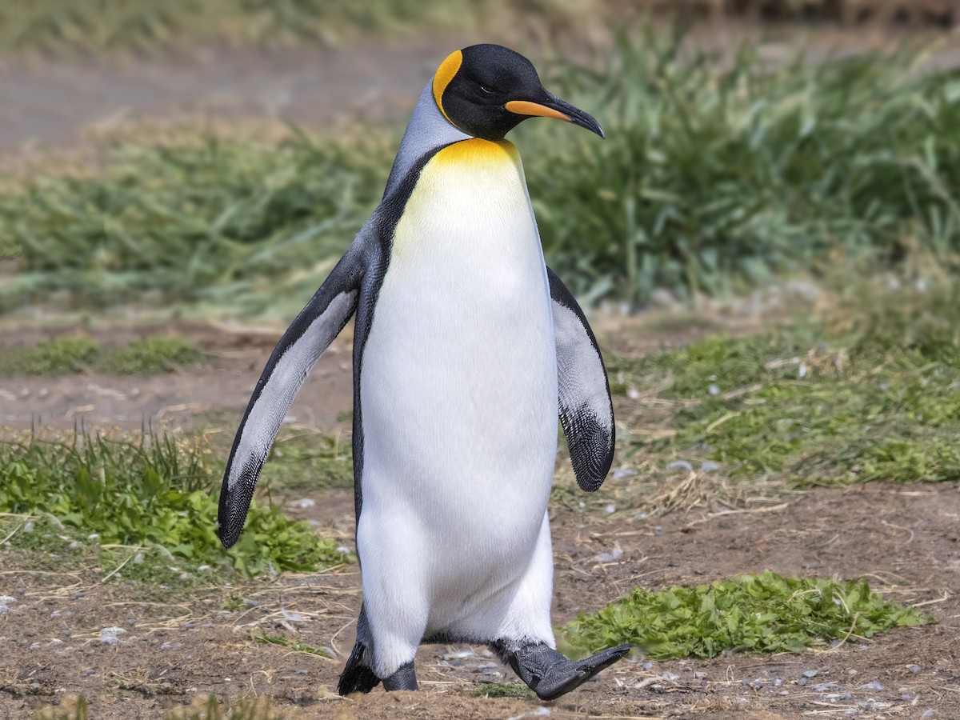
1
2
3

Slide 138
WHAT HAPPENED HERE?

Slide 139
BIRD
ROBIN
PENGUIN

Slide 140
A ROBIN IS A BIRD THAT HAPPENS TO BE A ROBIN

Slide 141
A PENGUIN IS A PENGUIN THAT HAPPENS TO BE A BIRD

Slide 142
ROBINS ARE TYPICAL BIRDS

Slide 143
PENGUINS ARE ATYPICAL BIRDS
Notes:
This actually has all kinds of interesting effects. For instance, if there’s a disease that affects robins, we’re more likely to assume that it affects all birds, than if there’s a disease that affects penguins.

Slide 144
TYPICAL CASES ARE CATEGORIZED AT THE BASIC LEVEL

Slide 145
ATYPICAL CASES ARE CATEGORIZED AT THE SUBORDINATE LEVEL

Slide 146
TROUBLE IN TAXONOMY TOWN

Slide 147
NON-TRANSITIVITY

Slide 148
A
IS-A
B
IS-A
C
IS-A

Slide 149
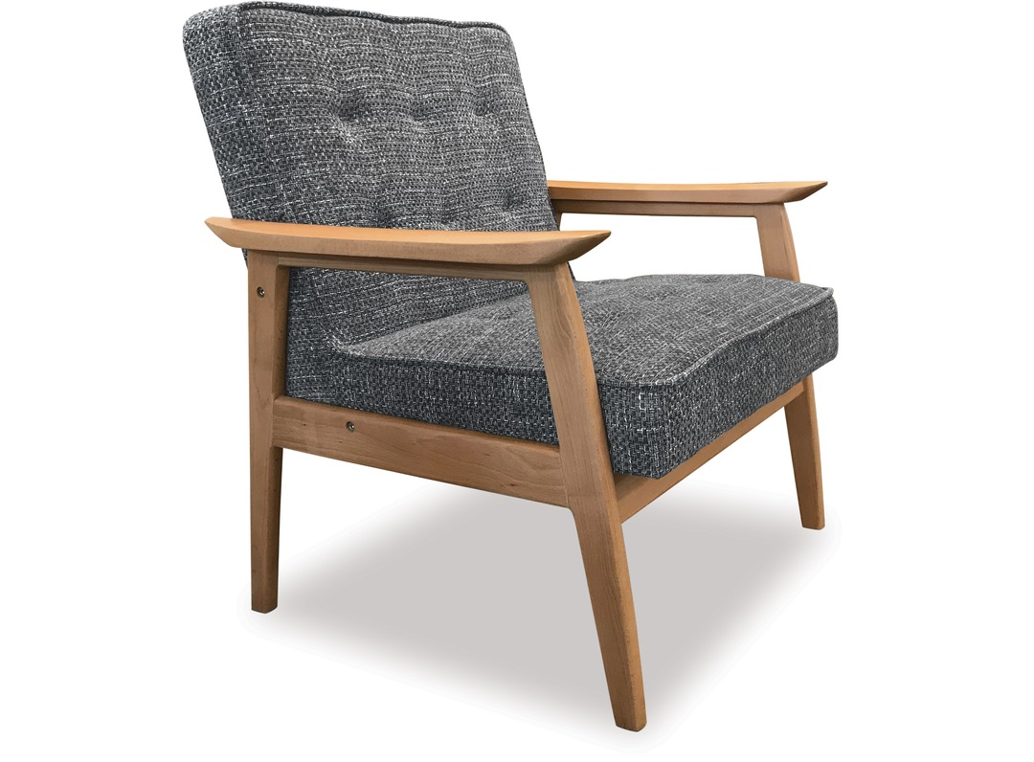

Slide 150
CHAIR IS FURNITURE?

Slide 151
CHAIR IS FURNITURE?
YES

Slide 152
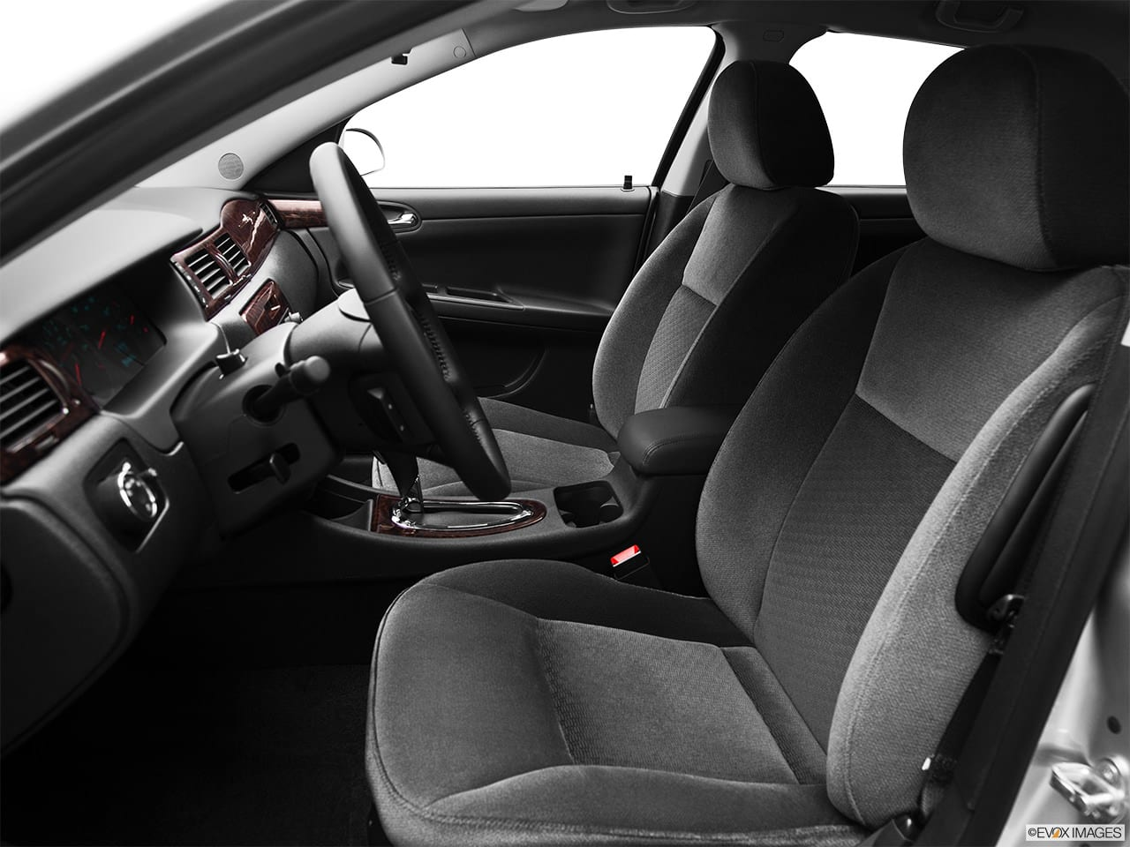

Slide 153
CAR SEAT IS CHAIR?

Slide 154
CAR SEAT IS CHAIR?
YES

Slide 156
CAR SEAT IS FURNITURE?

Slide 157
CAR SEAT IS FURNITURE?
NO

Slide 158
CAR SEAT
IS-A
CHAIR
IS-A
FURNITURE
IS-NOT-A

Slide 159
CATEGORIES ARE FUZZY

Slide 160
DEGREES OF MEMBERSHIP

Slide 161
EDGE CASES

Slide 162
NEGOTIATING CATEGORIES

Slide 163
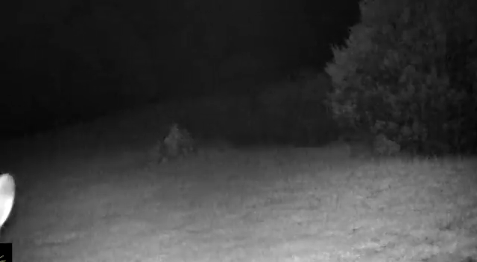

Slide 164
IS HTML A PROGRAMMING LANGUAGE?

Slide 165
DO WE WANT HTML TO BE A PROGRAMMING LANGUAGE?

Slide 166
DESCRIPTIVE VS NORMATIVE

Slide 167
THE PROBLEM IS NOT THE OBJECT BUT THE CATEGORY

Slide 168
CATEGORY DISCUSSION AS PROXY DISCUSSION

Slide 169
CATEGORY DEFINITION IS POWER OVER THE DOMAIN

Slide 170
IS X A MEMBER OF Y?

Slide 171
WHAT ARE THE IMPLICATIONS?

Slide 172
PROS AND CONS

Slide 173
TRADEOFFS

Slide 174
MODELLING

Slide 175
MODELLING AS TECHNIFICATION OF CATEGORIES

Slide 176
ELIMINATING AMBIGUITY

Slide 177
HANDLING EDGE CASES

Slide 178
TECHNIFICATION OF CATEGORIES HAVE SURPRISING CONSEQUENCES

Slide 179
NUTS ARE FRUITS?!?

Slide 180
ALMONDS ARE NOT NUTS?!?

Slide 181
WE’RE WRONG ABOUT EVERYTHING!!!

Slide 182
BUT WE’RE NOT WRONG

Slide 183
CONTEXT

Slide 184
EVERYDAY VS TECHNICAL CATEGORIES

Slide 185
TECHNICAL CATEGORIES FOR PRECISION

Slide 186
PRECISION COMES AT A COST

Slide 187
CATEGORIES AT NAV

Slide 188
VARIATIONS ON A THEME

Slide 189
UNMARRIED PEOPLE LIVING TOGETHER

Slide 190
TWO PEOPLE ABOVE 18 YEARS OF AGE WHO ARE NOT MARRIED, REGISTERED PARTNER OR LIVING WITH ANYONE ELSE

Slide 191
TWO PEOPLE WHO USUALLY LIVE TOGETHER EVEN IF THEY ARE TEMPORARILY SEPARATED

Slide 192
TWO PEOPLE LIVING IN THE SAME HOUSE, EVEN IF THEY LIVE IN SEPARATE PARTS OF THE HOUSE

Slide 193
[...] UNLESS THEY EACH LIVE IN SEPARATE UNITS IN A HOUSE WITH FOUR OR MORE INDEPENDENT AND CLEARLY SEPARATED UNITS

Slide 194
HAVE PREVIOUSLY BEEN MARRIED

Slide 195
LIVING TOGETHER IN A MARRIAGE-LIKE RELATIONSHIP

Slide 196
COULD LEGALLY GET MARRIED OR ENTER PARTNERSHIP

Slide 197
HAVE OR ARE EXPECTING CHILDREN TOGETHER

Slide 198
HAVE OR HAVE HAD CHILDREN TOGETHER

Slide 199
JOINT RESIDENCE

Slide 200
COMMON HOUSEHOLD

Slide 201
HAVE LIVED TOGETHER FOR AT LEAST 12 MONTHS

Slide 202
HAVE LIVED TOGETHER FOR 12 of the last 18 months

Slide 203
INTEND TO KEEP LIVING TOGETHER

Slide 204
PRECISION COMES AT A COST

Slide 205
EXPLOSION OF SIMILAR CATEGORIES

Slide 206
SIMPLIFICATION?

Slide 207
WE MUST CHOOSE

Slide 208
CHOICES ARE NOT RIGHT OR WRONG

Slide 209
CHOICES HAVE CONSEQUENCES

Slide 210
DECISIONS

Slide 211
IMPLICIT MODEL OF THE WORLD

Slide 212
IMPLICIT OPINIONS ABOUT WHAT MATTERS AND WHAT DOES NOT

Slide 213
TACIT ASSUMPTIONS

Slide 214
BETS AGAINST THE FUTURE

Slide 215
COMPOSABILITY OF ASSUMPTIONS AND DECISIONS
Notes:
Lose degrees of freedom.

Slide 216
ASSUMPTIONS AND DECISIONS ACCUMULATE OVER TIME
Notes:
Lose degrees of freedom.

Slide 217

ACCUMULATED ASSUMPTION LOAD

Slide 218
« TECHNICAL DEBT »

Slide 219
THE INEVITABLE BYPRODUCT OF CHANGE AND INERTIA

Slide 220
CHANGE IMPACT

Slide 221
HOW LONG DOES THIS FEATURE TAKE TO IMPLEMENT?

Slide 222
HOW DOES THIS FEATURE CHANGE OUR MENTAL MODEL?

Slide 223
HOW MANY ASSUMPTIONS ARE INVALIDATED?

Slide 224
HOW MANY DECISIONS MUST BE UNDONE AND REMADE?

Slide 225
HOW MUCH STRUCTURE RELIES ON THE INVALIDATED ASSUMPTIONS?

Slide 226
HOW MUCH STRUCTURE RELIES ON THE DECISIONS THAT MUST BE UNDONE?

Slide 227
TECHNICAL STRUCTURE

Slide 228
ORGANIZATIONAL STRUCTURE

Slide 229
PSYCHOLOGICAL STRUCTURE

Slide 230
RULES & REGULATIONS

Slide 231
ECONOMIC STRUCTURE

Slide 232
INTERTWINED MUTUALLY REINFORCING STRUCTURES

Slide 233
ENTRENCHMENT

Slide 234
OSSIFICATION

Slide 235
CONFLICT
MISUNDERSTANDING
AMBIGUITY
GENERALIZATION
INDECISION
Assumption
Notes:
Unwitting assumption.
Some indecision about architecture
Bet against the future
Some ambiguity of domain terms
Misunderstanding between teams
Conflict of vision

Slide 236
CONFLICT
MISUNDERSTANDING
AMBIGUITY
GAME OVER
GENERALIZATION
INDECISION
Assumption

Slide 237
CAN WE SLOW IT DOWN?

Slide 238
CAN WE REVERSE IT?

Slide 239
CAN WE WIN?

Slide 240
WE CAN PLAY SUCCESSFULLY

Slide 241
MODELLING IS OUR BEST BET

Slide 242
MODELLING AS DELIBERATE DESIGN OF TECHNICAL CATEGORIES

Slide 243
MODELLING IS DIFFICULT

Slide 244
MODELLING IS META-PROGRAMMING

Slide 245
DISCOMFORT

Slide 246
RELUCTANCE

Slide 247
« WHY ARE YOU MAKING IT SO COMPLICATED? »

Slide 248
TO AVOID MAKING IT UNNECESSARILY COMPLICATED OVER TIME

Slide 249
MODELLING IS TEACHABLE

Slide 250
LEARN ABOUT CATEGORIES

Slide 251

THE BIG BOOK OF CONCEPTS
GREGORY L. MURPHY

Slide 252

WOMEN, FIRE, AND DANGEROUS THINGS
GEORGE LAKOFF

Slide 254
